Slide 1
Meeting Five
DPM Final Project
Fall 2017
Team 6
GANTT and budget analysis, beta demo analysis, final testing plans, and finishing touches

Slide 2
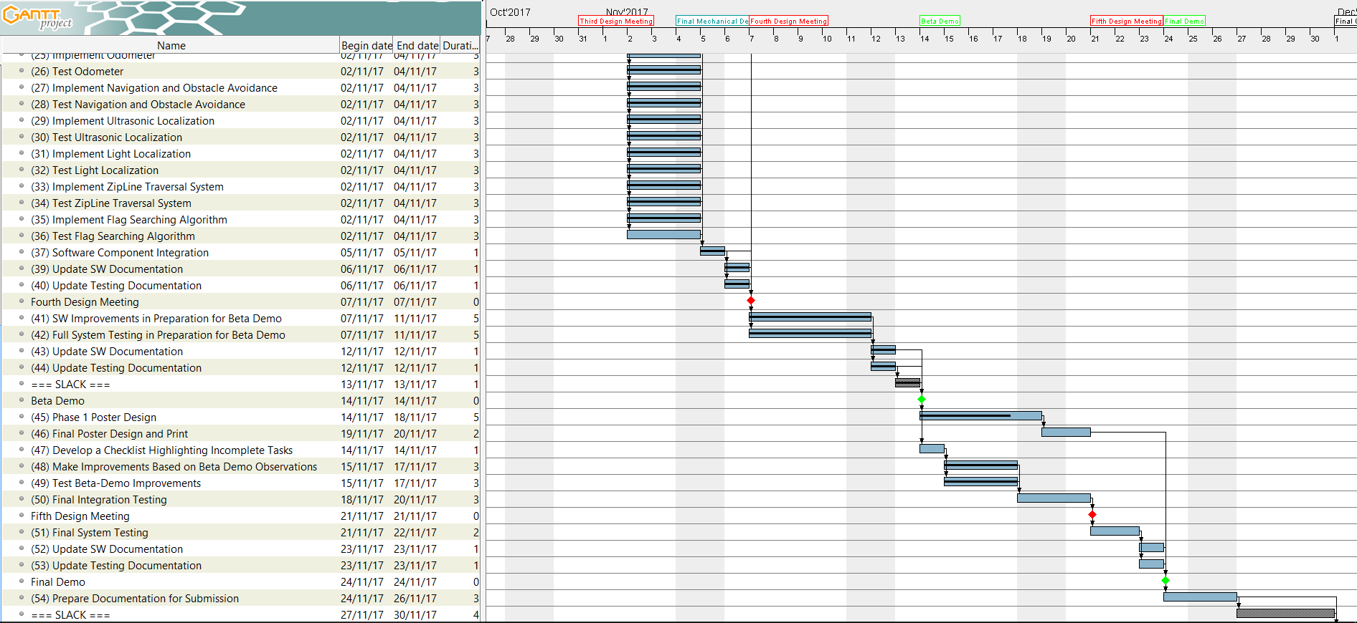
GANTT Chart Update

Slide 3
Budget Analysis

Slide 4
Beta Demo Performance Analysis
After a successful localization, the robot turned in the wrong direction and drove directly into a wall
Problem: ZC_R and Z0_R were used to form the robot’s path, and these values were inaccurate in the data provided from the game server
Our localization algorithm now uses the zip line start point and the length of the zipline to calculate the robot’s position upon landing
The testing team conducted an in-house beta demo to evaluate the progress of our robot

Slide 5
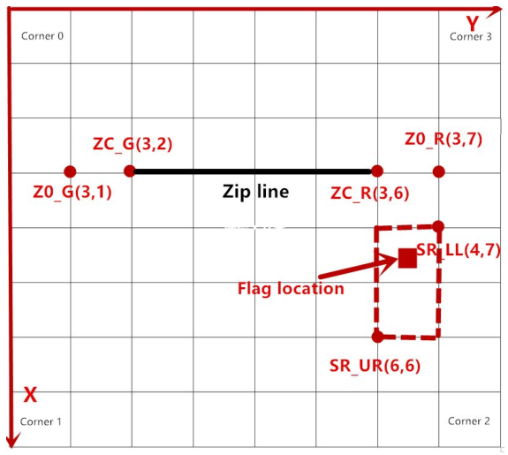
In-House Beta Demo – Corner 0
5/5 successful runs
arrives at searching zone with over 2.5 minutes remaining

Slide 6
In-House Beta Demo – Corner 1
5/5 successful runs
arrives at searching zone with over 2.5 minutes remaining

Slide 7
In-House Beta Demo – Corner 2
3/5 successful runs
In two runs, the robot failed to mount the zip line due to a large amount of accumulated error after navigating to the start of the zip line
In the successful runs, arrives at the searching zone with under two minutes remaining
This is not a concern – in the competition, the robot will not have to travel this far to mount the zip line.

Slide 8
In-House Beta Demo – Corner 3
5/5 successful runs
Arrives at the searching zone with under two minutes remaining
This is not a concern – in the competition, the robot will not have to travel this far to mount the zip line.

Slide 9
Final Software Touches – Searching Algorithm
The searching procedure is the most difficult part of the run
It is also the most untested, making it the most prone for failure
All other parts of the software database are complete – the searching algorithm will be the focus of this final week

Slide 10
Testing Plan – Final Week
Priority 1: Make sure everything works flawlessly when the searching algorithm is ignored
Full competition runs, neglecting searching:
Localize, navigate, zipline or cross the bridge, navigate to the searching zone, then return home via the appropriate method.
Priority 2: test the performance of the searching algorithm
Start the robot next to the searching zone, find the requested block, signal capture, then navigate away from the zone.
Priority 3: integrate the searching algorithm with the rest of the procedure
This integration should not present too many problems, but several tests will be run anyway.
Priority 4: full competition simulation runs

